Slide 1
Qt Quick Application Implement C++ functions
V1.0

Slide 2
More knowledge that we should get
What is Qt Quick project?
Components of Qt Quick project
Signal & Slot in Qt Quick project
Binding data in Qt Quick project
Connection between QML and C++
Common scenario

Slide 3
What is Qt Quick project ?
Qt Quick project is an C++ project ☺ which includes
C++ Back-end (Controller)
QML Front-end (UI)
Note: there are also an qml project which has only .qml files, but basically, it is still an C++ application.

Slide 4
Components of Qt Quick project
Qt Quick project has components:
Main.cpp: main process of application
<Project Name>.pro: project file which define components & properties of project
C++ Back-end (Controller): header (.h) & source (.cpp) files
QML Front-end (UI): QML (.qml) files
Resources: qml.qrc file manage all qml & other files of project
Other files: file for external usage when run or build application. For example:
External library: library for using in application. It can be .a , .dll, .so, etc files
External configuration file for build: AndroidMagnifest.xml, build.gradle for Android; Project-info.plist for iOS; etc

Slide 5
Using C++ class in QML
There are 2 ways to use C++ class in QML files:
Use C++ class to create an global object and use it in QML
Register C++ class and import it to QML later
In main.cpp
//first way: create an global object of class “appManager” to use in QML
QQmlApplicationEngine engine;
SampleClass appManager;
engine.rootContext()->setContextProperty("appManager", &appManager);
//second way: register C++ class “BackEnd” for using in QML (BackEnd version 1.0)
qmlRegisterType<SampleClass>(“Sample.BackEnd", 1, 0, "BackEnd");
In main.qml (for second way only)
import Sample.Backend 1.0

Slide 6
Signal & Slot in Qt Quick project
Signal and slot feature in Qt Quick project are very useful. It is used to define event trigger between objects (C++ / C++ or C++ / QML or QML / QML)
Signal is like event, Slot is like processing after event is triggered.
1 Signal can connect to many slots
Signal of class can call to its slot or slot of other classes.
When a signal is emitted, all its connected slot will be called.
We use “emit <signalName> to emit signal
We also catch signal as event & customize this event.
In C++, we simply implement function <signalName>.
In QML, we have to implement function with format “on<SignalName>” (add “on” word and first character of signal name must be capitalized)

Slide 7
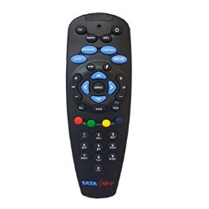
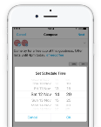
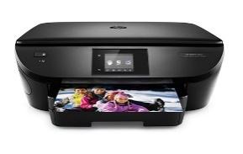
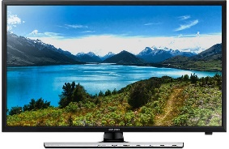
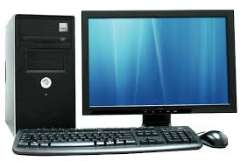
Signal & Slot in Qt Quick project
For example: we has
“remote” class ,which has signal “powerOn”.
“TV”, “Computer”, ”Smartphone”, ”Printer” classes have its own “start” function, these item will start after remote emit signal “powerOn”.
In Main.cpp, we will connect signal of remote to slot of other items
Connect(remoteObjectPointer, SIGNAL (powerOn()), tvObjectPointer, SLOT(startTV())
Connect(remoteObjectPointer, SIGNAL (powerOn()), pcObjectPointer,SLOT(startPC())
Connect(remoteObjectPointer, SIGNAL (powerOn()), spObjectPointer, SLOT(startSP())
Connect(remoteObjectPointer, SIGNAL (powerOn()), ptObjectPointer, SLOT(startPT())
When “emit powerOn()” is called, slot of other items will be executed automatically
Class Remote{
Signals:
powerOn()
}
Class TV{
slot:
startTV()
}
Class PC{
slot:
startPC()
}
Class Smartphone{
slot:
startSP()
}
Class Printer{
slot:
startPT()
}

Slide 8
Binding data in Qt Quick project
In Qt Quick project, we can easily bind data from C++ to display on UI (QML) by using signal.
Before binding data in Qt Quick project, we should understand about few things:
Q_OBJECT: this macro of Qt help Qt know this class is an Qt object, this class will be able to use supported functions of Qt for QObjects. It is especially useful for binding.
Q_INVOKABLE: this macro of Qt help Qt know this function of class can be called from QML
Q_PROPERTY: this macro of Qt help Qt know this property of class can be used (read / write / notify) in QML. Each property must have at least READ & NOTIFY methods.
READ: this method will be called when QML read data from C++ property
WRITE: this method will be called when QML write data to C++ property
NOTIFY: this signal will be called when value of this property is changed. When signal is emmited, QML will automatically call READ method to read value of this property again.

Slide 9
Binding data in Qt Quick project
Here is sample of C++ class which are using macros of Qt
class SampleClass : public QObject // inherit QObject
{
Q_OBJECT // define class as QObject
Q_PROPERTY(int sampleCount READ getSampleCount WRITE setSampleCount NOTIFY sampleCountChanged) //define property
public:
Q_INVOKABLE bool startupApplication(); //define invokable methods
Int getSampleCount(); // QML use this method to read data from C++
Void setSampleCount(int newValue); // QML use this method to write data to C++
signals:
Void sampleCountChanged; //signal when value of property is changed
}
Note:
Signal / property name must be in camel format as <camelName> (Invokable method should apply same rule).
In WRITE method, we will need to emit NOTIFY signal after value is changed.

Slide 10
Binding data in Qt Quick project
After having a class that use property / invokable method, now we can bind its data to QML.
TextField{
id: txtSampleTextField
text: sampleClass.sampleCount //piece of cakes ☺
// try to put some logs & run
}
Note:
property can be basic types (int, string, etc) or object, list.
If property is an object or a list, we should define it as QVariant property, Qt will help us do remain work.

Slide 11
Binding data in Qt Quick project
We can bind list of C++ object as model for views (Listview, Repeater, etc) in QML. Each objects will be a “modelData” which will be used for delegate
ListView{
id: txtSampleTextField
model: appManager.objectlist //objectlist is a property of AppManager class
// try to put some logs & run
}
Note: objectlist is a list (QList) of Object pointer (QObject*)

Slide 12
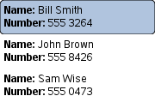
C++: objectlist (QList<>)
QML: Listview
Qobject*
=
modelData
name: "Bill Smith" number: "555 3264“
QObject*
=
modelData
property
Value of property
name: "Sam Wise" number: "555 0473"
name: "John Brown" number: "555 8426“
Note:
objectlist must be cast to QVariant when using in QML
If objectlist is a StringList or list of basic type (int, string,etc)
then we do not need to cast it to QVariant

Slide 13
Connection QML and C++
Sometimes, we need C++ back-end emit some signals to trigger process on QML. It can be done by using Connection in QML. All we need are:
In C++ class, we need a signal to emit
In QML, we need an Connection object
Note: in QML, we can not use intelligent code when using Connection, but don’t worry about that.

Slide 14
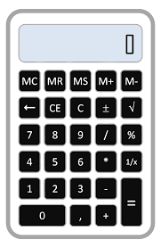
Connection QML and C++
For example: we have an calculator application. We need to display result value after calculation (in C++) is finished
Calculator.cpp
Class CalculatorClass : public QObject{
Q_OBJECT
Q_PROPERTY (int resultValue….) // define property
public:
Q_INVOKABLE void startCalculate(); // calculation method
signals:
void finishCalculation(); //signal to emit
// signal name has no “on” and first character is not capitalized
}
Calculator.qml
Rectangle{
id: recCalculator
Text{
id:txtResult //use to display result
}
Button{
id:btnOperatorEqual
onClicked:{
startCalculate(); //call invokable method to calculate
}
Connection{
target: calculatorClass // host of signal
onFinishCalculation:{ // process when signal is emmited
txtResult.text = calculatorClass.resultValue // get new result
}
}
}
}

Slide 15
Common Scenario
There is also a case that we use only QML for whole application but we do not discuss it here.
In this scenario, we are using Controller in C++ with UI in QML.
C++ class
QML
Q_PROPERTY
Read / write value only
Display value
Q_INVOKABLE
Handle action and process data
Action
signal
Emit signal to trigger update on UI after processing data
event

Slide 16
Common Scenario
C++ child class
Q_PROPERTY
QML
C++ class
C++ child class
Display value
Q_PROPERTY
Q_PROPERTY
Action
Q_INVOKABLE
event
signal
C++ child class
Q_PROPERTY
Note: Q_PROPERTY is not “public member” for other C++ class.

Slide 17
Q & A

Slide 18
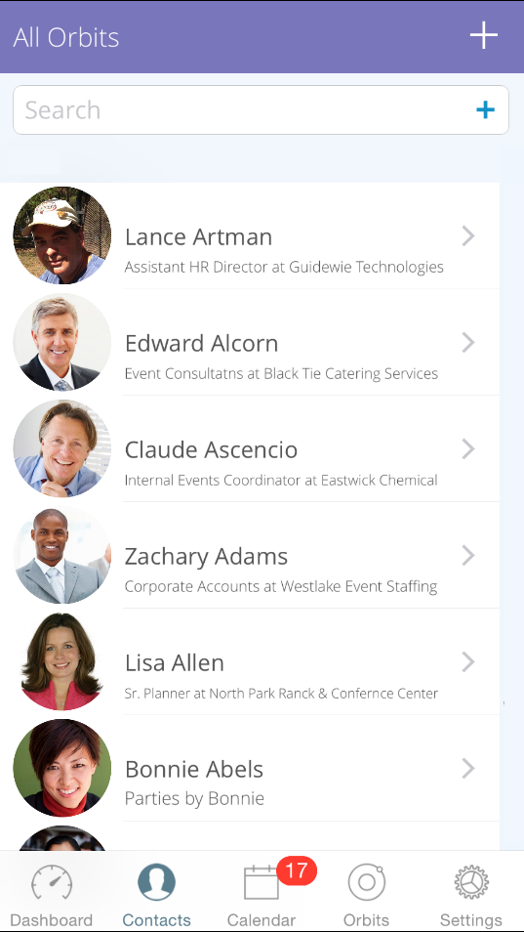
Exercise
Sample A: Create application as list of contact
Target:
Get list of “Contact” from facebook by searching
Display list of “Contact” class (C++) in “Contacts” screen
Suggestion: using Qt class
For internet access (HTTP / HTTPS request) : QNetworkAccessManager, QNetworkReply , QNetworkRequest, QEventLoop
For analyzing REST API data
QJSonObject
QJSonDocument
QJSonArray
For hobby
Contact & Custom class… ☺ (self-define)

Slide 19
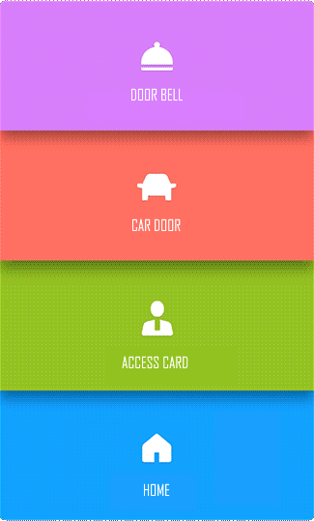
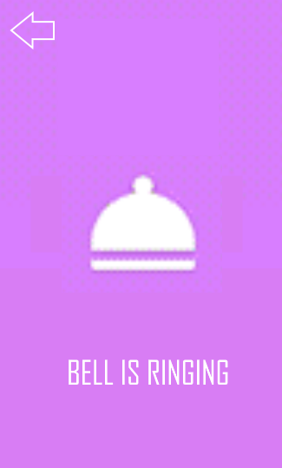

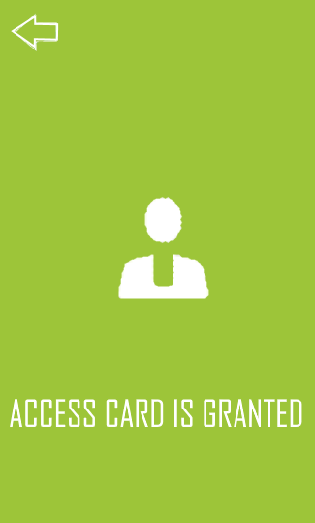
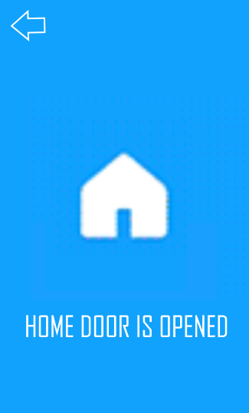
Exercise
Sample B: Create application as list of location
Target:
Scan and display list of location by BLE
Connect to location via BLE
Suggestion: using Qt class
- BLE communication: QBluetoothDeviceDiscoveryAgent, QBluetoothServiceDiscoveryAgent, QLowEnergyController, QBluetoothServiceInfo
For hobby: Location & other class… ☺ (self-define)

